Slide 1
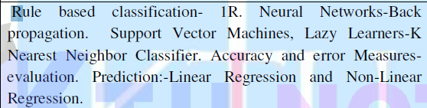
Module 4

Slide 2
Rule-Based Classification

Slide 3
Rule-based classifiers
IN rule-based classifiers the learned model is represented as a set of IF-THEN rule
A rule-based classifier uses a set of IF-THEN rules for classification.
An IF-THEN rule is an expression of the form IF condition THEN conclusion.
An example is rule R1,
R1: IF age = youth AND student = yes THEN buys computer = yes.

Slide 4
Rule-Based Classification
The “IF”-part (or left-hand side) of a rule is known as the rule antecedent or precondition.
The “THEN”-part (or right-hand side) is the rule consequent.
In the rule antecedent, the condition consists of one or more attribute tests (such as age = youth, and student = yes) that are logically ANDed.
The rule’s consequent contains a class prediction (in this case, we are predicting whether a customer will buy a computer).

Slide 5
Rule-Based Classification
R1 can also be written as
R1: (age = youth) ^ (student = yes) ) (buys computer = yes).
If the condition (that is, all of the attribute tests) in a rule antecedent holds true for a given tuple, we say that the rule antecedent is satisfied and that the rule covers the tuple.

Slide 6
Coverage and accuracy.
A rule R can be assessed by its coverage and accuracy.
Given a tuple, X, from a class-labeled data set, D, let n_{covers} be the number of tuples covered by R;
n_{correct} be the number of tuples correctly classified by R; and |Dj| be the number of tuples in D.

Slide 7
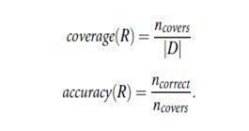
we can define the coverage and accuracy of R as

Slide 8
Coverage and accuracy
That is, a rule’s coverage is the percentage of tuples that are covered by the rule
i.e., whose attribute values hold true for the rule’s antecedent.
Rule’s accuracy is the percentage of tuples that the rule can correctly classify.

Slide 9
Coverage and accuracy example
Our task is to predict whether a customer will buy a computer. Consider rule R1: IF age = youth AND student = yes THEN buys computer = yes.
which covers 2 of the 14 tuples.
It can correctly classify both tuples.
Therefore, coverage(R1) = 2/14 = 14.28%
and accuracy(R1) = 2/2 = 100%.

Slide 10
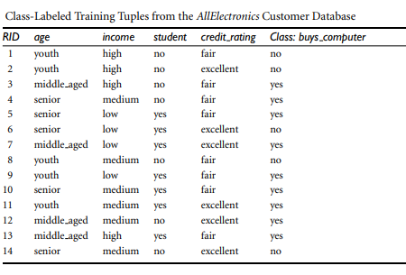
Class labeled tuples from the AllElectronics customer database.

Slide 11
Rule-Based Classification
If a rule is satisfied by X, the rule is said to be triggered.
For example, suppose we have
X= (age = youth, income = medium, student = yes, credit rating =fair).
We have to classify X according to buys computer.
X satisfies R1, which triggers the rule.
If R1 is the only rule satisfied, then the rule fires by returning the class prediction for X.
Note that triggering does not always mean firing because there may be more than one rule that is satisfied

Slide 12
Rule-Based Classification
If more than one rule is triggered, we need a conflict resolution strategy to figure out which rule gets to fire and assign its class prediction to X.
There are many possible strategies. They are
Size ordering
Rule ordering.

Slide 13
size ordering
The size ordering scheme assigns the highest priority to the triggering rule that has the “toughest” requirements
where toughness is measured by the rule antecedent size.
That is, the triggering rule with the most attribute tests is fired.
Eg:
R1: IF age = youth AND student = yes THEN buys computer = yes.
R2:IF age = youth, income = medium, student = yes, credit rating =fair THEN buys computer = no.

Slide 14
rule ordering
The rule ordering scheme prioritizes the rules beforehand.
The ordering may be
class-based
rule-based.
With class-based ordering, the classes are sorted in order of decreasing “importance,” such as by decreasing order of prevalence.
That is, all of the rules for the most prevalent (or most frequent) class come first, the rules for the next prevalent class come next, and so on.

Slide 15
rule ordering
With rule-based ordering, the rules are organized into one long priority list, according to some measure of rule quality.
The measures of rule quality includes
· Accuracy
· Coverage
· size (number of attribute tests in the rule antecedent) · based on advice from domain experts.
When rule ordering is used, the rule set is known as a decision list.
With rule ordering, the triggering rule that appears earliest in the
list has highest priority, and so it gets to fire its class prediction.
Any other rule that satisfies X is ignored.

Slide 16
Rule Extraction from a Decision Tree
To extract rules from a decision tree, one rule is created for each path from the root to a leaf node.
Each splitting criterion along a given path is logically ANDed to form the rule antecedent (“IF” part).
The leaf node holds the class prediction, forming the rule consequent (“THEN” part).

Slide 17
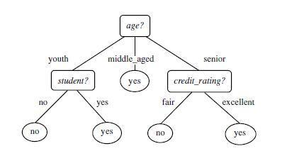

Slide 18
